Slide 1

Utilization Of Facebook
Presented by :
Ramprakash Tripathi
Data Analyst.
EXECUTIVE PROGRAM IN DATA SCIENCE & AI .
Find Me :
Email : ramprakashtripathi108@gmail.com
LinkedIn : linkedin.com/in/ramprakash-tripathi-aa86771a7

Slide 2


UTILIZATION OF FACEBOOK…
Utilization Of Facebook

Slide 3
Utilization Of Facebook
“Data is what you need to do
ANALYTICS.
Information is what you need to do
BUSINESS..”

Slide 4



Utilization Of Facebook
PROCESS ROADMAP AND TOOL
DATA ACQUISITION AND DESCRIPTION
PROBLEM STATEMENT
INSTALL & IMPORT LIBRARIES
DATA PRE-PROFILING
INTRO
DATA PRE-PROCESSING
DATA POST
PROFILING
EDA
CONCLUSION

Slide 5
Utilization Of Facebook
Facebook is American Social Media platform , which was founded in 2004 by Mark Zuckerburg.
2. Facebook is free of charge, and the company earns most of its money from advertisements on the website.
3. Multiple uses of this platforms are : Business man uses for their businesses, Teachers uses for teaching, student uses for study and Others uses for different Promotions and advertisements.

Slide 6
Utilization Of Facebook
People from all over the world are still using it as a medium to share their thoughts and feelings among others.
With the rise in the popularity of the application it is very necessary to stay updated and they are trying really hard. Let's say they want to study and analyze these differences and identify the pattern out of it
This is result will help the company to utilize these patterns in the next set of iteration development.
Maybe this hidden pattern could end up improving their application and the user experience.

Slide 7
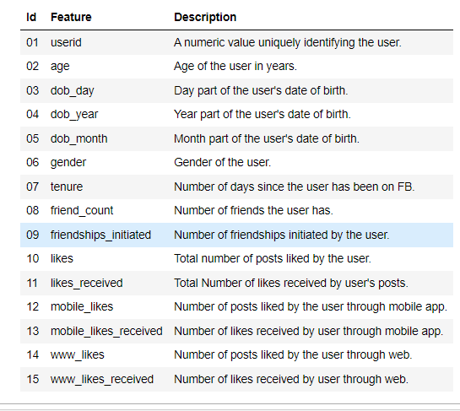
Utilization Of Facebook
GIVEN DATA SET

Slide 8
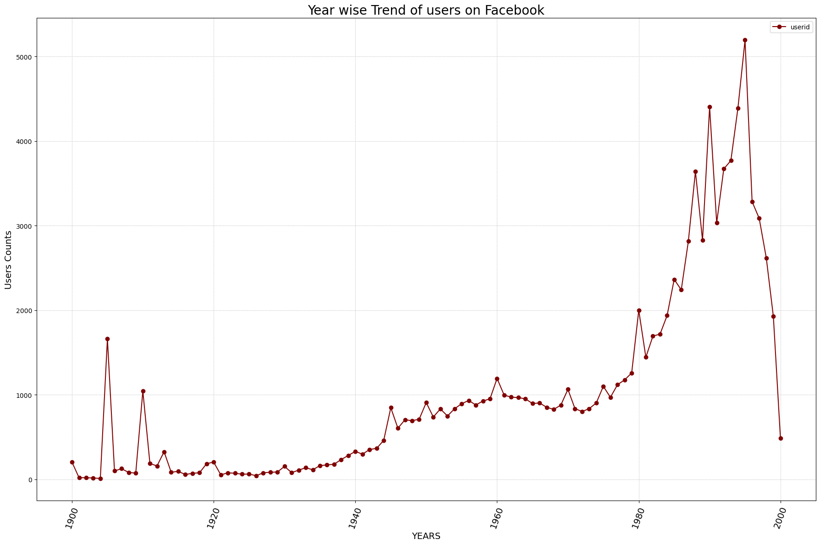
Utilization Of Facebook
Utilization Of Facebook
Utilization Of Facebook

Slide 9
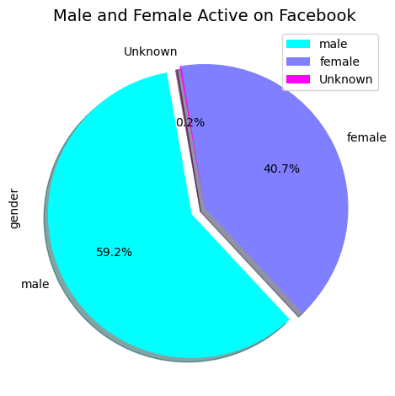
Utilization Of Facebook
Utilization Of Facebook
Utilization Of Facebook

Slide 10
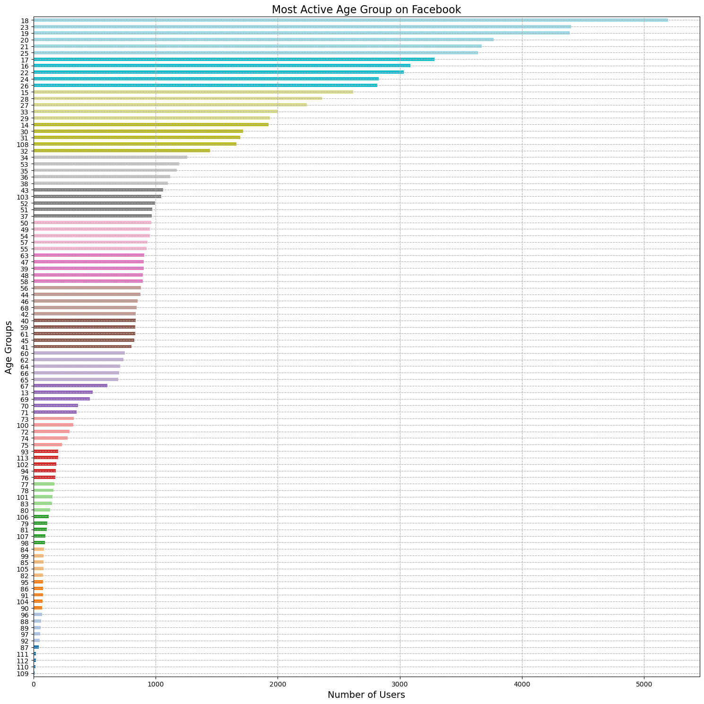
Utilization Of Facebook
Utilization Of Facebook
Utilization Of Facebook

Slide 11
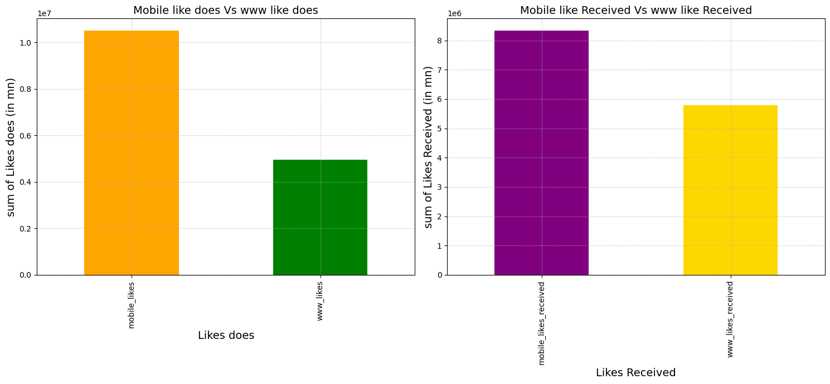
Utilization Of Facebook
Utilization Of Facebook
Utilization Of Facebook

Slide 12
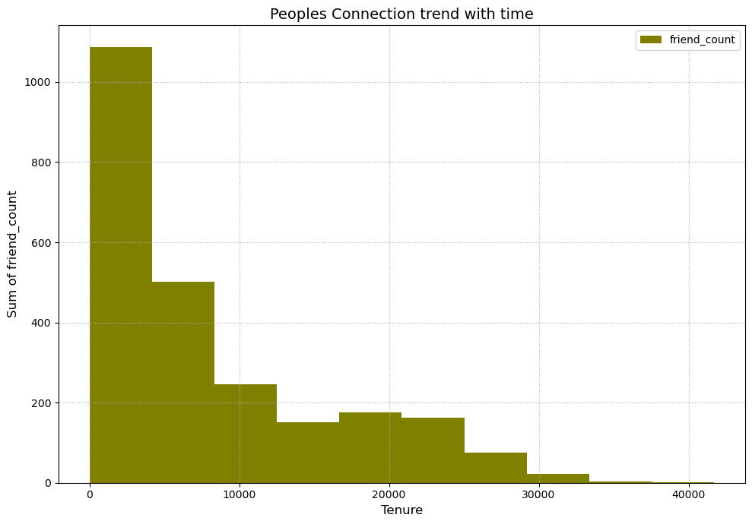
Utilization Of Facebook
Utilization Of Facebook
Utilization Of Facebook

Slide 13
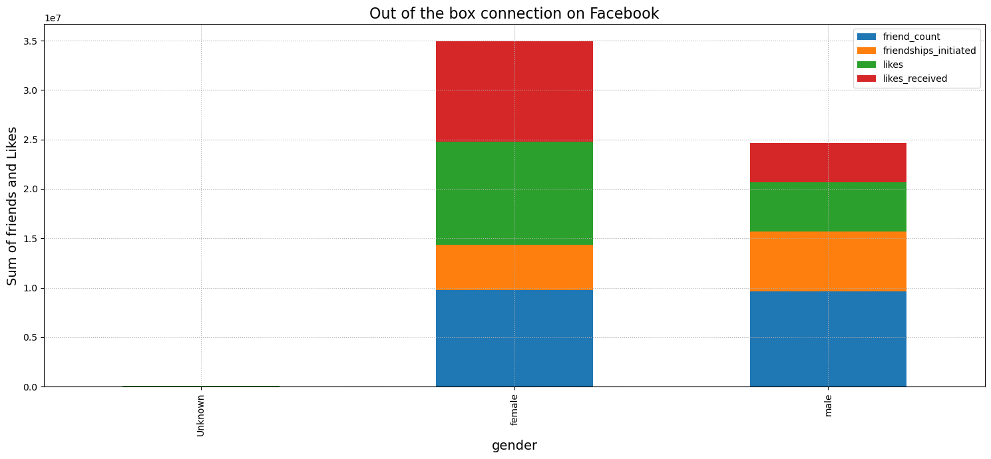
Utilization Of Facebook
Utilization Of Facebook
Utilization Of Facebook

Slide 14
Utilization Of Facebook
Utilization Of Facebook
Utilization Of Facebook
Conclusion
1.Facebook was at it's peak between 1990 to 2000, at most in 1995.
2.Number of people registered on Facebook platform , mostly was of young age , specially people of 18 years.
3.People desire more connection on social media(Facebook) then they are known to, specially females.
4.People who has been since so long on Facebook , generally like to prefer surfing for media only, instead of looking for connection with others.

Slide 15
Utilization Of Facebook
Utilization Of Facebook
Utilization Of Facebook
ACTIONABLE INSIGHT
1.Facebook should spread proper awareness of pro and cons on their platform as most users are youngster.
2.while upgrading the platform time to time , Facebook should have more upgrade surffing feature for those who has been since so long on platform and prefer to surf then connect, so by this way even they find helpful for them and even Facebook can enhance their earning as well.
3.As people are more desired for more connection, Facebook search engine should be work accordingly to auto suggest them their knowns.

Slide 16
Utilization Of Facebook
Utilization Of Facebook
Utilization Of Facebook
THANK’YOU
For any query :
Email : ramprakashtripathi108@gmail.com
LinkedIn : linkedin.com/in/ramprakash-tripathi-aa86771a7

